Slide 1
CMAC 3990.200
Systems Administration and Operations
Fall 2025 – Week 10.1 – October 28th, 2025
More Network Services, Runlevels, Reviews and such

Slide 2

Objectives
Weekly Info
Other network services
SSH
E-Mail
VoIP
Firewalls
Remote Access Service
VNC
SNMP
Disk configurations
Compiling from source
Docker Compose
Package Installs
  Owncloud
  NextCloud
Runlevels
Scrpiting
The process of an attack
VPN
Common attacks and exploits
Scripting basics
Crontab files
Information Security Awareness
Security Tools and Assessment Sites
Network Security
Looking for a target
Targets of opportunity
Targets of choice

Slide 3

Weekly Info
Nothing can be called a service
until it is monitored!
Attendance
Good of the class
Presentation Reminder
  Presentation Date: December 2nd, 2025
Remaining Points (846 total):
  Attendance (weeks 10-15): 30 points
  Presentation & Project: 300 points
  4 Assignments: 250 points
    50-75 points each
  Final Exam: 266 points

Slide 4
Projects
Provide a report and presentation on a specific topic
  Walk through what the service does, what you installed, why you picked it, why we need it
  Do a deep dive on the topic and implement tools on your Linux VM or in the cloud (if applicable)
    Cloud, git, cli interfaces, infrastructure as code…
Presentation
  5-10 minute discussion of topic, each team member must present a portion
  History of topic, who first implemented it, what it does, why it is necessary…
  Basic implementation – How did you install?
    Walkthrough and documentation of steps that can be given to a junior admin!
    PowerPoint or another presentation showing steps with pictures will help!
    Live examples where possible!
Report and Assessment
  Documentation, description of services, implementation guide, etc.
Report info under Week 3!

Slide 5
Assignment 9 Review
Use the following long file listing to answer the questions on the next slide:
  drwx--x--x. 11 jason jason 4.0K Feb 13 13:58 .
  drwxr-xr-x. 14 root root 4.0K Aug 24 2015 ..
  -rwx------ 1 jason jason 82 Sep 12 2014 attach.sh
  -rw-------. 1 jason jason 16K Feb 23 23:09 .bash_history
  -rw-r--r--. 1 jason jason 18 Feb 21 2013 .bash_logout
  -rw-r--r--. 1 jason jason 176 Feb 21 2013 .bash_profile
  -rw-r--r--. 1 jason jason 124 Feb 21 2013 .bashrc
  drwx------ 3 jason jason 4.0K May 28 2013 .config
  drwx------. 4 jason jason 4.0K Dec 5 12:28 .irssi
  -rw------- 1 jason jason 59 Jul 5 2014 .lesshst
  drwxr-xr-x 3 jason jason 4.0K Feb 13 13:58 .libvirt
  drwx------. 2 jason jason 4.0K Aug 20 2014 miau
  drwx------. 7 jason jason 4.0K Feb 3 18:57 misc
  -rw------- 1 jason jason 13 Nov 18 2014 notes.txt
  -rw-r--r-- 1 jason jason 24 May 26 2013 .oidentd.conf
  drwx------. 4 jason jason 4.0K May 24 2013 old
  drwx------ 2 jason jason 4.0K Feb 20 20:15 .ssh
  -rwx------ 1 jason jason 115 Oct 22 2014 test.sh
  drwx------. 2 jason jason 4.0K Feb 13 15:26 tmp
  -rw------- 1 jason jason 51 Jun 4 2013 .tmux.conf
  drwx------. 7 jason jason 4.0K Sep 11 19:35 wraith

Slide 6
Assignment 9 Review
Use the previous long file listing to answer the questions:
  1. Which files are executable?
    -rwx------ 1 jason jason 82 Sep 12 2014 attach.sh
    -rwx------ 1 jason jason 115 Oct 22 2014 test.sh
  2. What are the directories?
    drwx--x--x. 11 jason jason 4.0K Feb 13 13:58 .
    drwxr-xr-x. 14 root root 4.0K Aug 24 2015 ..
    drwx------ 3 jason jason 4.0K May 28 2013 .config
    drwx------. 4 jason jason 4.0K Dec 5 12:28 .irssi
    drwxr-xr-x 3 jason jason 4.0K Feb 13 13:58 .libvirt
    drwx------. 2 jason jason 4.0K Aug 20 2014 miau
    drwx------. 7 jason jason 4.0K Feb 3 18:57 misc
    drwx------. 4 jason jason 4.0K May 24 2013 old
    drwx------ 2 jason jason 4.0K Feb 20 20:15 .ssh
    drwx------. 2 jason jason 4.0K Feb 13 15:26 tmp
    drwx------. 7 jason jason 4.0K Sep 11 19:35 wraith

Slide 7
Assignment 9 Review
Use the previous long file listing to answer the questions:
  3. What files and folders are hidden?
    drwx--x--x. 11 jason jason 4.0K Feb 13 13:58 .
    drwxr-xr-x. 14 root root 4.0K Aug 24 2015 ..
    -rw-------. 1 jason jason 16K Feb 23 23:09 .bash_history
    -rw-r--r--. 1 jason jason 18 Feb 21 2013 .bash_logout
    -rw-r--r--. 1 jason jason 176 Feb 21 2013 .bash_profile
    -rw-r--r--. 1 jason jason 124 Feb 21 2013 .bashrc
    drwx------ 3 jason jason 4.0K May 28 2013 .config
    drwx------. 4 jason jason 4.0K Dec 5 12:28 .irssi
    -rw------- 1 jason jason 59 Jul 5 2014 .lesshst
    drwxr-xr-x 3 jason jason 4.0K Feb 13 13:58 .libvirt
    -rw-r--r-- 1 jason jason 24 May 26 2013 .oidentd.conf
    drwx------ 2 jason jason 4.0K Feb 20 20:15 .ssh
    -rw------- 1 jason jason 51 Jun 4 2013 .tmux.conf

Slide 8
Assignment 9 Review
Use the previous long file listing to answer the questions:
  4. What files can be read by everyone?
    -rw-r--r--. 1 jason jason 18 Feb 21 2013 .bash_logout
    -rw-r--r--. 1 jason jason 176 Feb 21 2013 .bash_profile
    -rw-r--r--. 1 jason jason 124 Feb 21 2013 .bashrc
    drwxr-xr-x 3 jason jason 4.0K Feb 13 13:58 .libvirt
    -rw-r--r-- 1 jason jason 24 May 26 2013 .oidentd.conf
  5. What command (and parameters) did I most likely use to generate the file listing above?
    ls -lah

Slide 9
Assignment 9 Review
Answer the following questions:
  6. How many root name servers currently exist? List one.
    13 – a through m.root-servers.net
      k.root-servers.net 193.0.14.129, 2001:7fd::1 RIPE NCC
      l.root-servers.net 199.7.83.42, 2001:500:9f::42 ICANN
  7. Who is the Technical Contact for the Edinboro.edu domain? What command did you use to arrive at that answer?
    Command: whois edinboro.edu
        Technical Contact:
          Domain Tech
          Pennsylvania Western University
          250 University Avenue
          California, PA 15419-1394
          USA
          +1.8147321071
          domain-tech@pennwest.edu

Slide 10
Assignment 9 Review
Answer the following questions:
  8. Explain the function of a recursive DNS server.
    A recursive DNS server looks up DNS records for us, starting at the root of the DNS hierarchy, and recursively searching through the different levels to find the desired record.
  9. Explain the purpose of a CNAME record, and give an example of where one might be used.
    A DNS CNAME record is aa alias, or “nickname,” that maps to another record.
    This is often used with the www hostname, making the record “www.domain.com” point to “domain.com”
      Ex: www.sophiedogg.com. 14350 IN CNAME sophiedogg.com.
      sophiedogg.com. 1994 IN A 139.177.204.38
  10. What is an advantage of the classless IP addressing system?
    Flexibility in allocating IP addresses
    More efficient use of IP space
    Scalability of subnet sizes
    Simplified routing configurations
    Standardized CIDR notation

Slide 11
Assignment 9 Review
Answer the following questions:
  11. What is a DNS Glue record?
    The A or AAAA record of a DNS server at the parent.
  12. The top most servers in the DNS hierarchy are called what?
    Root servers
  13. What does TLD stand for? Give an example of two TLD’s.
    Top Level Domain
    .net, .com, .org, .edu, .biz, .horse…

Slide 12
Assignment 9 Review
Answer the following questions:
  14. Find the following DNS values for the ultrastuff.net domain (5 points):
    Serial number: 135
    NS Servers (hostnames and IP):
      ns-cloud-b1.googledomains.com - 216.239.32.107
      ns-cloud-b2.googledomains.com - 216.239.34.107
      ns-cloud-b3.googledomains.com - 216.239.36.107
      ns-cloud-b4.googledomains.com - 216.239.38.107
    MX Servers: mail1.ultrastuff.net & mail2.ultrastuff.net
    Registry Expiration Date: 2026-03-17T16:21:18Z
  15. Given the following classless IP addresses, determine the IP address range
    IP Address Starting IP Ending IP Subnet Mask
    192.168.0.0/24 192.168.0.0 192.168.0.255 255.255.255.0
    10.11.1.0/16 10.11.0.0 10.11.255.255 255.255.0.0
    147.64.243.0/23 147.64.242.0 147.64.243.255 255.255.254.0
    8.8.8.8/20 8.8.0.0 8.8.15.255 255.255.240.0

Slide 13
Assignment 9 Review
Answer the following questions:
  16. Given the following classful IP addresses, determine the IP class, network ID, and host ID
      IP Address IP Class Network ID Host ID
      192.168.0.1 C 192.168.0 .1
      252.65.32.77 E n/a n/a
      24.93.201.102 A 24 .93.201.102
      147.64.32.6 B 147.64 .32.6
      8.8.8.8 A 8 .8.8.8
  17. List one of each of the following DNS records for google.com
      Record Type Record
      A 172.217.15.110
      AAAA 2607:f8b0:4004:811::200e
      NS ns1.google.com
      MX 10 aspmx.l.google.com.
      SOA ns1.google.com. dns-admin.google.com. 297077745 900 900 1800 60

Slide 14

SSH
SSH is a suite of network communication tools
  Based on open standards, guided by the Internet Engineering Task Force (IETF)
  100% Encrypted
  Remote connections
  File transfer
  Tunnels
  Uses Public Key Cryptography
    Senders private key, combined with destinations public key
    Destinations private key is used to decrypt
    Sufficiently large keys prevent reverse engineering
  Uses session keys
    Changed regularly
    Shared over secure communication session
    Extra shared key used to encrypt transmissions

Slide 15
SSH
SSH Keys
  A large number with special mathematical properties
  Key length is measured in bits
    128 bit key has 2^128 possibilities
  Larger key sizes create more possible permutations
  2048-bit or higher
  Higher encryption levels require more computation
  Various key types
    RSA, DSA, EDSA
Encryption Algorithms
  SSH can use many different encryption algorithms
  Both parties must agree!

Slide 16
SSH
Asymmetrical Encryption
  Public/Private Key
    Public key can/must be shared with others!
    Private key must be kept secret!
  Used during the initial key exchange process used to set up the symmetrical encryption
    Both parties produce temporary key pairs and exchange the public key in
    order to produce the shared secret that will be used for symmetrical encryption.
  Used for SSH key-based logins
    After secure communications have been established, the public/private SSH key-
    based login credentials can be validated
  Public key cryptography - Diffie-Hellman Key Exchange (8:37)
    https://www.youtube.com/watch?v=YEBfamv-_do

Slide 17
SSH
Symmetrical Encryption
  A type of encryption where one key can be used to encrypt messages to the opposite party, and also to decrypt the messages received from the other participant. This means that anyone who holds the key can encrypt and decrypt messages
  Symmetric keys are used by SSH in order to encrypt the entire connection!
    Public/private asymmetrical key pairs are only used for authentication
  Shared secret or shared key encryption
  Both parties contribute toward establishing this key
    Key exchange algorithm
    Both parties create the same key independently, by sharing certain
    pieces of public data and manipulating them with certain secret data.
  AES, Blowfish, 3DES, CAST128, Arcfour

Slide 18
SSH
Hashing
  Methods of creating a signature; the same input should create the same hash output every time
  Never meant to be reversed; the hash cannot be reversed
  Virtually impossible to influence predictably
  Practically unique
  Mainly used for data integrity purposes, and to
  verify the authenticity of communication
  Hash-based message authentication codes (HMAC)
    These are used to ensure that the received data is intact and unmodified
  Hashes also often used to verify downloads
    If the has of a software package is known, and you compute a different hash,
    your download is bad!
  Every message sent after the encryption is negotiated must contain
  a Message Authentication Code (MAC) for validation.
    Calculated from the symmetrical shared secret, packet sequence number, and content

Slide 19
SSH
Establishing Connection Session
  The client is begins the initial TCP handshake with the server
    Server responds with supported protocol versions, common protocol is agreed upon
    Server provides public key
  Secure connectivity is negotiated using a Diffie-Hellman algorithm
    Each party will combine their private data with public data from the other system
    This allows each machine to arrive at an identical secret session key
    Prevents any one source from controlling the key
  Server identity is verified
    Communication is now encrypted, and identification information is shared
    over the encrypted link, validating hosts
  Credentials are provided to authenticate
    User login information can now be encrypted and transmitted

Slide 20
SSH
Diffie-Hellman Process
  Both parties agree on a large prime number which serves as a seed value.
  Both parties agree on an encryption generator (typically AES)
  Independently, each party comes up with another secret prime number
    This number is used as the private key for this interaction
  The generated private key, the encryption generator, and the shared
  prime number are used to generate a public key
  Both participants then exchange their generated public keys.
  The destination machine uses their private key, the source machines
  public key, and the original shared prime number to compute a
  shared secret key.
    Independently computed by each party, using opposite private and public keys,
    it will result in the same shared secret key.
  This shared secret is then used to encrypt all communication

Slide 21
SSH
Authentication
  Password authentication
    Relatively small, simple, can be exploited relatively easily
  Key-based authentication - Asymmetric SSH key pairs
    Client sends an account ID for the key pair it would like to authenticate with
    Server checks the authorized_keys file of the requested account
    If a public key match is found, the server generates a random number
    and uses the public key to encrypt the number and send to the client
    If the client has the associated private key, it can decrypt the message,
    revealing the original number
    The client combines the decrypted number with the shared session key
    to calculate the (MD5) hash of this value.
    The client then sends this hash back to the server as an answer
    to the encrypted number message.
    The server uses the same shared session key and the original number
    to calculate the hash value on its own. The values are compared,
    and if these values match, the client is authenticated.

Slide 22
SSH
SSH configuration files
  /etc/ssh/sshd_config - Server side configuration
    Ciphers, host info, port, protocol, tcp forwarding, X11 forwarding, listenining IP
  /etc/ssh/ssh_config - Client side configuration
    Default client connection configuration
  ~userhome/.ssh (/home/user/.ssh)
    User specific information
    Public and private keys for one user
Secure Copy
  scp hostserv:sourcefile destserv:destfile
    scp /etc/sudoers server1:/etc/sudoers
SFTP
  FTP over SSH

Slide 23
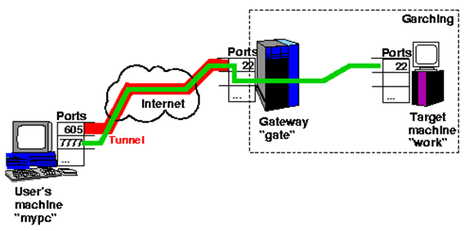
SSH
Tunnels!
  -L LPORT:HOST:DPORT
  ssh -L 19999:127.0.0.1:19999 ecsc3990-110.cs.edinboro.edu
    Local port forward, good for TCP tasks like SSH, VNC, RDP, etc.
  -D SOCKSPORT
  ssh -D 54321
  ssh -D 54321 ecsc3990-110.cs.edinboro.edu
    Dynamic Socks Proxy!
    Dynamic port forward
  Multiple tunnels
  Tunnels inside of tunnels
  “Proxy servers”
ssh –L 7777:work.domain.tld:22 user@gate.domain.tld

Slide 24
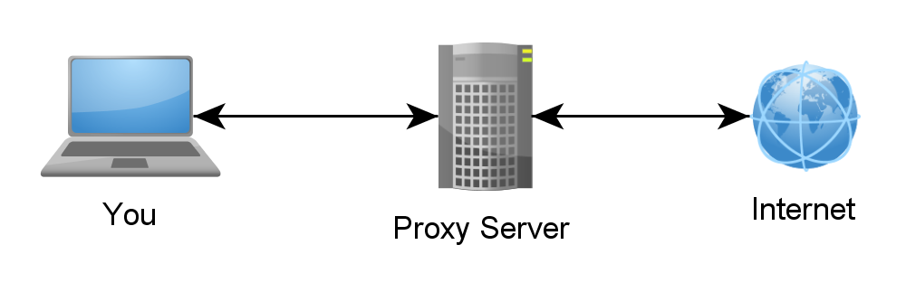
SSH Tunnels
SSH Tunnels are secure and encrypted between endpoints!
Local port forwarding
  Similar to port forwarding on a router
  ssh -L source_port:destination_host:destination_port user@host.tld
    Ex: ssh –L 8080:cmac3990-110.cs.edinboro.edu:80 cs_student@jpatalon.cs.edinboro.edu
    This command opens an encrypted tunnel between my local machine and ssh server jpatalon.cs.edinboro.edu
    Traffic sent to localhost port 8080 is redirected to cmac3990-110.cs.edinboro.edu port 80

Slide 25
SSH Tunnels
SOCKS (Dynamic) Proxy
  Allows for website proxying
  Can be used to allow connections around firewalls
    Connect to your cmac3990 web server from anywhere through an intermediate host
  ssh -D port user@host.tld
    Ex: ssh –D 55510 cs_student@jpatalon.cs.edinboro.edu
    This command opens an encrypted tunnel between your local machine and ssh server jpatalon.cs.edinboro.edu
    Web SOCKS traffic is sent through port 55510 to server jpatalon.cs.edinboro.edu, where it is then forwarded to the destination

Slide 26
SSH Tunnels
Combined SSH SOCKS proxy and local tunnels
  ssh –D 55510 –L 33890:147.64.243.110:3389 cs_student@jpatalon.cs.edinboro.edu
  This creates a tunnel through server jpatalon.cs.edinboro.edu
  This allows us to do both a local port forward and a dynamic port forward
  Connecting to localhost port 33890 is forwarded to 147.64.243.110 port 3389 through jpatalon.cs.edinboro.edu
  A dynamic SOCKS proxy is set up through localhost port 55510
  The connection is encrypted between the localhost and jpatalon.cs.edinboro.edu

Slide 27
SSH Tunnels
Multi-hop ssh tunnels
ssh -D 55555 -L 55556:127.0.0.1:55556 -L 55557:127.0.0.1:55557 cs_student@jpatalon.cs.edinboro.edu
ssh -D 55556 -L 55557:127.0.0.1:55557 user@147.64.243.110

Slide 28
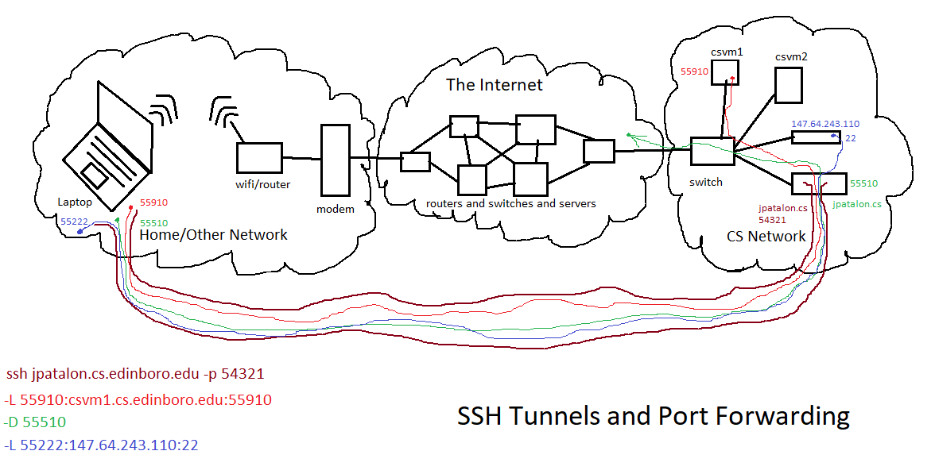

Slide 29
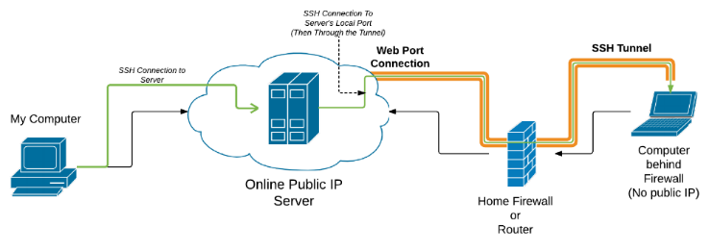
Reverse SSH Tunnel
Open an SSH connection that allows additional connections in the opposite direction!
  Ex: I open a reverse SSH tunnel from my house to jpatalon.cs.Edinboro.edu with port 32123
    ssh -R 32123:localhost:22 cs_student@jpatalon.cs.edinboro.edu -p 54321
    A tunnel from jpatalon.cs.Edinboro.edu on port 32123 will now be forwarded to the originating (localhost) machine port 22
    This will allow anyone to connect to localhost port 32123 on jpatalon.cs.Edinboro.edu and go through the tunnel!
    Log on to jpatalon.cs.Edinboro.edu, open a SSH connection to localhost port 32123, it is actually going to my machine!
      Yeah you don’t have an account, so you can’t login.
    This only works while my SSH tunnel is open!

Slide 30
Reverse SSH Tunnel
Open an SSH connection that allows additional connections in the opposite direction!
  How about multiple tunnels?
    I run this from my machine: Reverse tunnel on jpatalon port 32123 to my house on port 19999, and port 32122 to port 22…
      ssh -R 32123:10.11.187.1:19999 -R 32122:localhost:22 cs_student@jpatalon.cs.edinboro.edu –D 54321
    You can then connect to http://localhost:32123 and access the netdata instance behind it, on my local network…
      Open a local proxy from anywhere to jpatalon.cs.Edinboro.edu…
      ssh -L 32124:localhost:32123 cs_student@jpatalon.cs.edinboro.edu –D 54321
      Open a browser connection to http://localhost:32124 !
        Localhost port 32124 goes through
        your SSH tunnel to jpatalon localhost port 32123
        Jpatalon localhost port 32123 goes through
        my SSH tunnel to 10.11.187.1 port 19999
          Jpatalon localhost port 32122 goes through
          my SSH tunnel to the originating localhost server port 22
        You are connecting to the Netdata instance on my local network!
    This still only works while my SSH tunnel is open!

Slide 31
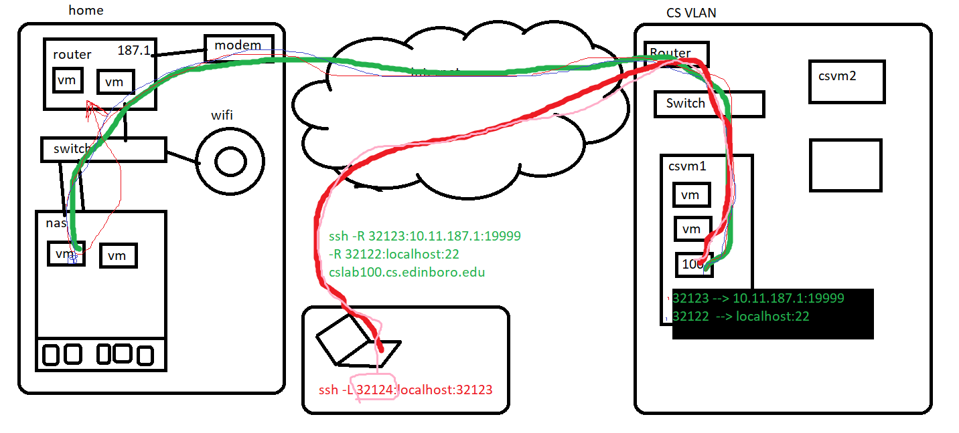
Reverse SSH Tunnel

Slide 32

E-Mail
Highly used, highly visible
  Outages are unacceptable
  Reliability should be of extreme importance
Strong foundations of reliability are needed first
  Documentation is key
  Simple, clear, well-understood design and architecture
  Standard protocols
Communicated and acknowledged privacy policy!
  Who can read what emails, expectation of privacy
    Hint: don’t ever expect privacy in emails!
  Improper usage of company resources
    Don’t conduct personal business over company email servers,
    or using any other company owned resources!

Slide 33
E-Mail
Namespaces should be carefully considered
  Email addresses must be unique!
  Firstname.Lastname@company.com seems good, until there are two employees with the same name!
    Firstname.lastname2@company.com?
Email is a utility service
  Like electricity or the telephone, people expect it to work, all the time!
  Design and build with reliability in mind!
  Hot spares, secondary systems, HA clusters, etc.
Simplicity
  Limit the e-mail system to specified machines
    Do not involve desktop systems!
  The fewer parts involved, the fewer parts that can break
    Just like a RAID array, failure chances increase with hardware footprint

Slide 34
E-Mail
Email transport mechanisms
  Mail Transport Agent (MTA)
    Gets mail from server to server
    Sendmail, postfix
  Mail Delivery Agent (MDA)
    Receive mail at destination server for storage
    procmail
  Access Servers
    Provide protocols (POP3, IMAP) that allow mailbox access
  Mail User Agent (MUA)
    Client application that access email servers
    Outlook
  Processing and Filtering
    Process email lists
    Filter spam

Slide 35
E-Mail
Spam and virus blocking
  Junk e-mail can comprise more than half of all received mail!
  Block as much as possible at the server level
    Don’t give the users an opportunity to open the virus!
  Perform additional client-side scanning
    Can also find viruses from different sources
  Keep spam definitions up to date!
    Similar to virus definitions, spam software has definitions
Automate common tasks
  New user creation, load balancing
Monitor your system
  Ping replies, responding ports, disk space, CPU/RAM utilization, etc
  Postmaster!

Slide 36
E-Mail
Security Issues
  Mail relay hosts can be a popular target
    Many relay hosts have connections to both internal and external networks
  Scan email before it gets delivered to a users computer
    Some files can’t be scanned!
    Denial of service attacks
  Internal and external servers
    External servers handle sending and receiving off-site
    Don’t allow external servers to be used as an open relay!
  Remote access
    VPN
    Additional servers for remote access
  Segregation of duties

Slide 37
E-Mail
Encryption systems
  Encrypt an e-mail message
  Provide an encrypted, authenticated location integrated with e-mail
Retention Policies
  Have a specific retention policy
  Might be dictated by government or exchange policy
Scalable
  Monitor your systems for bottlenecks
  Design your system in a fashion that can be scaled relatively easily
High-Volume Processing
  Mailing lists (distribution lists) should be handled by a server
  Dedicated machines for high-volume mailing lists

Slide 38

VoIP
Voice over IP – The transmission of digitized speech in data packets across one or more networks
Overview
  Speech is captured from a microphone and converted from analog to digital
  Digital information is encoded, compressed, and broken in to packets
  Packets are sent across the network to the destination
  Packets are decompressed and decoded at the destination
  Digital signal is converted to analog for playback
VoIP Server – Central communications switch
  Directs, mitigates, and controls VoIP communications
  Provides ways for end users to interact with the VoIP systems
Analog Telephone Adapter
  Allows you to connect a standard analog phone to your VoIP network

Slide 39
VoIP
IP Phones
  Hard (physical) phones
    Phone has built-in VoIP software, and mimics a traditional analog phone
    Cisco 7490G
    Consolidates ATA, software, and analog phone
    Built in network switch ports; port configuration/speed
    Quality of Service
  Soft (virtual) phones
    Software on a device that emulates phone calling functions
    Software can be on a PC, smart phone, tablet, etc.
    Can be great for international travel!
  Traditional phones with ATA devices
    MagicJack, ObiHai, etc.
    Home use
    Free home phone?!

Slide 40
VoIP
VoIP Protocols
  A typical VoIP connection involves a series of handshakes between endpoints, called signaling
  Endpoints maintain two persistent media streams (full duplex)
  Custom protocols are created to handle the exchange
  Signaling protocols
    Control the creation, change, and removal of a conversation
    Focus on multiple aspects of the conversation
      Verifying the identities of the involved parties
      Ensuring proper usage and authorization
      Advertising capabilities
    H.323, MGCP, Session Initiation Protocol (SIP), SCCP aka Skinny, XMPP
  Media protocols
    Transport multimedia data over IP networks
    RTP, RTCP (RFC 3550!)
    Carry data streams with connectionless UDP packets, designed to be independent of underlying layers

Slide 41
VoIP
VoIP Protocols
  Codecs (coder-decoder)
    Instructions used to convert analog signals to & from digital signals
    Sound/video quality, bandwidth, requirements
    G.711, G.722, G.723.1, GSM, iLBC, Speex
VoIP Implementations
  Replace Private Branch Exchanges (PBX)
    Asterisk – Community software for building VoIP PBX Replacements
      Create powerful, programmable VoIP systems with many features at a low cost
        Voicemail, call waiting, conference calling, automatic call distribution, etc.
  Public Switched Telephone Network (PSTN)
    Plain Old Telephone Service (POTS)
Virtual Telephony?!
  Don’t forget about network, port, or firewall requirements!
QoS!

Slide 42

Firewalls
The Linux kernel packet filter and firewall tools is called Netfilter
Netfilter maintains a list of rules, specifying how packets on an interface should flow
Various tools are used to configure Netfilter
  iptables – ipv4 packet management
    Most common Linux firewall implementation
  ip6tables – ipv6 packet management
  nftables – newer, faster replacement for iptables
    nft command
  arptables – filter traffic based on ARP information (MAC address)
  firewalld – RHEL7/CentOS7 dynamic firewall manager
    firewall-cmd – User-space iptables tool
    Allows for dynamic modifications without connection interruptions

Slide 43
Firewalls
Netfilter breaks the tasks into several distinct tables for certain operations
  Network Address Translation (NAT) table – changing IP source or destination addresses,
  and maintaining a list of the current connections
  Mangle table – Alters or marks tables, such as QoS packet marking
  Raw table – Mainly used for marking packets not to be handled
  by the connection tracking system
  Security table – Used for managing MAC rules
  Filter table – Used for applying rules to packets, specifying what
  packets, protocols, header information, are allowed, and much more
    Allow TCP port 22, Limit incoming ping requests to 1 per second, logging, etc.
  Create chains within filters
    Execute the set of rules in one chain before another set of rules
    Block known invalid traffic before accepting authorized traffic

Slide 44
Firewalls
Network Area Translation (NAT) is used to hide hosts on either side of the firewall
  Source NAT (SNAT) – Changes the source IP address and port of a packet, to appear to come from another, authorized, location.
    When a private network needs to use a single public IP
    Requires knowledge of public IP address
      DHCP should use masquerading instead
  Destination NAT (DNAT) – Changes the destination IP address and
  port of a packet, directing the packet to a different location
    Map external IP address to internal IP addresses
    Maintain a DMZ
    Manage multiple IP’s from a single host (choke point)
  Masquerading – A special type of SNAT, used when the public IP
  address is configured via DHCP
    SOHO Router

Slide 45
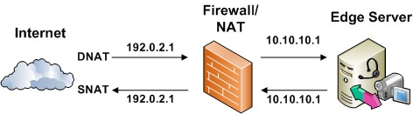
Firewalls
Source & Destination NAT Example

Slide 46
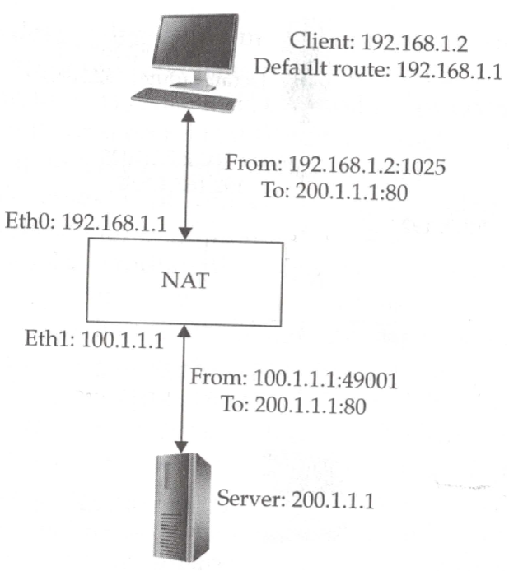
Firewalls
Source NAT Example
The NAT engine
maintains a list of
server-client connections

Slide 47
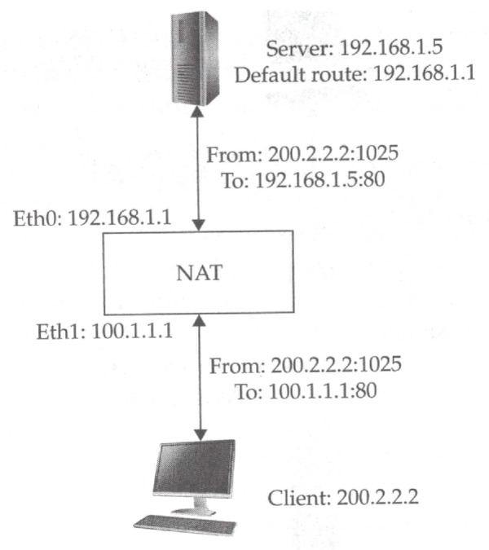
Firewalls
Destination NAT Example
The NAT engine
maintains a list of
server-client connections

Slide 48
Firewalls
The Netfilter engine also provides stateful connection tracking
  By itself, NAT does not understand content flows
  Stateful connection tracking can reject incorrect packets
    New HTTP connection established with incorrect packets
  Specific protocols are picky and don’t like NAT
    FTP uses an active data stream, which must be handled differently
    IM, Streaming, IRC, VoIP, others have NAT-friendly modes
    UPnP – Dynamic client port forwarding requests (xbox/playstation/etc.)
Packets flow through a series of chains in specific tables
  NAT, Mangle, and Filter tables
  Can create custom chains
    Bogons - a route that should never appear in the Internet routing table
    Incorrectly marked packet headers
    Invalid IP locations

Slide 49
Firewalls
Packets flow through a series of chains in specific tables
  Prerouting chain – First chain an incoming packet sees
    NAT, Raw, or Mangle tables
    Connection tracking, DNAT functions
  Forward chain – When packets are destined for another system
    Filter and Mangle tables
    Forwarding must be enabled!
    Routes packets to correct interfaces, based on packet-filtering rules
  Input chain – When packets are destined for the host itself
    Filter and Mangle tables
    Accepts/rejects/drops packets, based on packet-filtering rules
  Output chain – Outbound packets originating from the host
    NAT, Filter, and Mangle tables
  Postrouting chain – Alter source IP’s for SNAT
    NAT and Mangle tables

Slide 50
Firewalls
firewalld
  firewalld uses zones to define levels of trust for connections
  Rules are assigned to specific zones
    drop, block, public, external, dmz, work, home, internal, trusted
  Predefined lists of ports and protocols for ease of use
    ssh (22/tcp), http (80/tcp), https (443/tcp), etc.
  firewall-cmd used to interact with firewalld
    firewall-cmd --get-default-zone
    firewall-cmd --get-zone-of-interface=enp0s3
    firewall-cmd --list-all
    firewall-cmd --zone=public --add-port=5000/tcp
    firewall-cmd --zone=public --add-service=http
    --permanent flag makes a rule active on boot

Slide 51

Remote Access Service
Gives authorized individuals a way to access the company network from home, customer sites, or other locations around the world
  Remote Access Policies!
Direct connections into network, via dial-up networks or dedicated connections
Encrypted tunnels using public internet services
  End-to-end encryption!
Low cost, easy, convenient customer access solution
  Web-based, standards based
Work-at-home solutions
  Additional potential of failure outages
  Limited to areas with high-speed internet
  Additional costs

Slide 52
Remote Access Service
Centralize remote access service administration
  Security choke points
  Limited points of entry
  Ease of management
Potential for outsourcing
  Frequently changing technologies
  Economies of scale
Protect as a guest network
  People connecting through the remote should have more restrictive access
  May have access to selected internal resources
  Separate with a vlan, routing, and different physical interfaces and devices
Guest Wi-Fi Networks
Encryption!

Slide 53

VNC
We already did this!
Virtual Network Computing (VNC)
  Graphical desktop sharing system that uses the Remote Frame Buffer protocol (RFB) to remotely control another computer. – Wikipedia
  Transmits keyboard, mouse, and graphics
  VNC Server – Destination of the VNC connection
  VNC Client – Source of the VNC connection
  VNC Protocol – Network protocol working at the framebuffer level
    RFB – Remote Framebuffer Protocol
  Typically not encrypted!
    Traffic protocol is inherently insecure
    Encrypt through secure SSH tunnels!
      -L 5901:127.0.0.1:5901
  TCP Connection
    Typically at ports 5900-5999

Slide 54
VNC
We already did this!
Quick Install 1/2
  Set up VNC connection to OS GUI
  Install Tiger VNC server software
    dnf -y install tigervnc-server
  Copy the service file in place
    This file provides the startup services for user #1, on port 5900+1!
      cp /lib/systemd/system/vncserver@.service /etc/systemd/system/vncserver@:1.service
  Add TCP firewall port 5901
    firewall-cmd --zone=public --add-port=5901/tcp --permanent; firewall-cmd --reload

Slide 55
VNC
We already did this!
Quick Install 2/2
  Switch to user and run the vncserver command to create a vnc password
    su – user
    vncserver
  Set new service to run at boot
    systemctl daemon-reload
    systemctl enable vncserver@:1.service --now
  Attempt to open a VNC connection to your server on port 5901!
Use the username user!

Slide 56
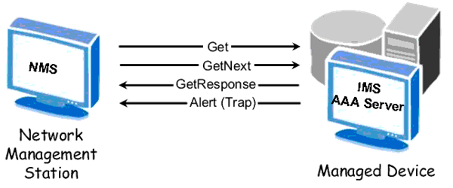
SNMP
Simple Network Management Protocol (SNMP)
Queries a device for the value of a variable
  GET IF-MIB::ifOutOctets.1
    Bytes sent out interface #1
  Many different available variables to query
    Group of variables is called a Management Information Base (MIB)
    Different vendors may implement different variables
Change a variable setting on a device
  PUT
Create traps
  Send an alert message when a
  particular variable threshold is met

Slide 57
SNMP
Simple Network Management Protocol
Configured through passwords and SNMP access groups
  Passwords called community strings are used
  Community strings are shared, and not very secure
  Early versions were not encrypted
Only allow known hosts to access SNMP system
Use non-standard community strings
Limit what data can be seen and what
data can be changed
Use latest versions of SNMP where possible
  SNMP v3
Use UDP for
less overhead!

Slide 58

Runlevels
Linux has traditionally provided multiple different run-levels
  States of the running machine configuration
  0 – Halt – What to do when stopping the server
  1 – Single user mode – no networking and minimal set of running processes
  2 – Multi-user mode – no networking or networking dependent processes
  3 – Multi-user mode – Full networking, command line console
  4 – User-defined
  5 – Multi-user mode w/ GUI – Full networking, GUI console
  6 – Reboot – what to do when rebooting the server
Initd based systems configure the default runlevel in /etc/inittab
Systemd based systems use systemctl commands
  systemctl get-default
  systemctl set-default multi-user.target
Linux Standard
Base Spec

Slide 59

Scripting
Bourne Again Shell (BASH)
  Indicated with the line “#!/bin/bash” at the beginning of the script file
  Supports variables, functions, etc.
    If, then, else
    For, while loops
    Variable manipulation
    Support for any Linux commands, including output redirect, piping, and more
  File /root/updateme.sh
      #!/bin/bash
      dnf clean all --enablerepo=*
      rm -rf /var/cache/dnf
      dnf -y update kernel
      dnf -y update kernel*
      dnf -y update
Don’t forget to set the script executable!

Slide 60
Scripting
Bourne Again Shell (BASH)
  Indicated with the line “#!/bin/bash” at the beginning of the script file
  Supports variables, functions, etc.
  File /root/backups.sh
      #!/bin/bash
      mkdir -p /backups
      rsync -avz /etc /backups/
      rsync -avz /root /backups/
      rsync -avz /home /backups/ --exclude="students/"
Put your script in your crontab:
  Edit your crontab with crontab -e
    # Minute Hour Day of Month Month Day of Week Command
    # (0-59) (0-23) (1-31) (1-12 or Jan-Dec) (0-6 or Sun-Sat)
    30 2 * * * /root/backups.sh
      This runs at 2:30AM every day
Don’t forget to set
the script executable!

Slide 61
Crontab
List your current crontab entries with crontab -l
Edit/list another user’s crontab with crontab -u
  Ex: crontab -lu user
Edit your crontab with crontab -e
  # Minute Hour Day of Month Month Day of Week Command
  # (0-59) (0-23) (1-31) (1-12 or Jan-Dec) (0-6 or Sun-Sat)
  30 2 * * * /root/backups.sh
    This runs at 2:30AM every day
Crontab’s are edited with the default editor!
  Usually the default editor is vi, change with:
    export VISUAL="nano"
    export EDITOR="nano"
Crontab is like Windows Scheduled Tasks

Slide 62
Scripting
Bourne Again Shell (BASH)
  How about an update script?!
      #!/bin/bash
      dnf clean all --enablerepo=*
      rm -rf /var/cache/dnf
      dnf -y update kernel
      dnf -y update kernel*
      dnf -y update
  Clean up any cached items
  Update just the kernel *by itself*
  Update any remaining related kernel packages
  Update the rest of the system
Don’t forget to set
the script executable!

Slide 63
OpenVPN
Create an encrypted tunnel between a device and your server.
Android, iPhone, Mac OSX, Windows, Linux…
Install the service on your server
  Install the OpenVPN server software and any prerequisites (epel-release YUM repository)
Configure the server-side service settings
  Startup, port, protocol, DNS, DHCP, network/subnet, firewall, NAT & forwarding, server-side encryption settings
  Server-side user settings, profiles, keys, and certificates
Configure the client side
  Install the OpenVPN client software on your client device
  Securely copy the OpenVPN server and client keys, certificates, and configurations to the client
  Import settings into your client and validate!

Slide 64
nmap
Install nmap to scan ports!
  dnf install nmap
Use nmap!
  nmap <options> <IPADDRESS>
  nmap 10.1.187.155
  nmap -sP 10.1.187.115
    nmap -sP 10.1.187.1/23
  nmap –p 1-65535 10.1.187.115
  Flags:
    -sn: Ping scan
    -p: Scan specified ports

Slide 65
CMAC 3990.200
Systems Administration and Operations
Fall 2025 – Week 10.2 – October 30th, 2025
More Network Services, Runlevels, Reviews and such

Slide 66
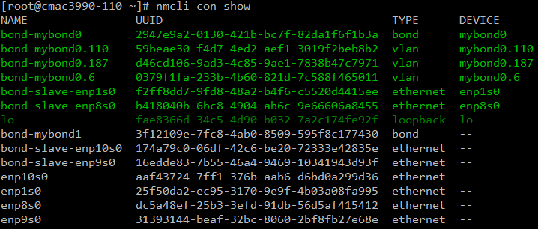

Network Changes
Create a new bond on the private network
  Create a new network bond interface:
    nmcli con add type bond ifname mybond1 bond.options "mode=balance-rr,miimon=100"
  Add our network interfaces in to the bond:
    nmcli con add type ethernet ifname enp9s0 master bond-mybond1
    nmcli con add type ethernet ifname enp10s0 master bond-mybond1
Assignment 12

Slide 67
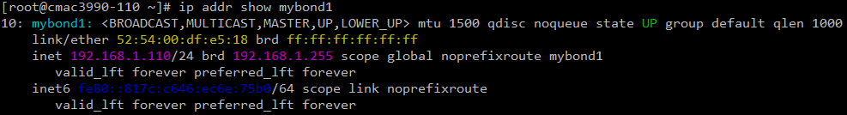
Network Changes
Configure new bond interface
  Disable the bond so we can reconfigure it:
    nmcli con down bond-mybond1
  Configure the IP address for our new network bond connection:
    nmcli con mod bond-mybond1 ipv4.method manual ipv4.addresses 192.168.1.1##/24
      Notice there are no gateways or dns servers configured here!
  Bring the new network bond online:
    nmcli con up bond-mybond1
Assignment 12

Slide 68
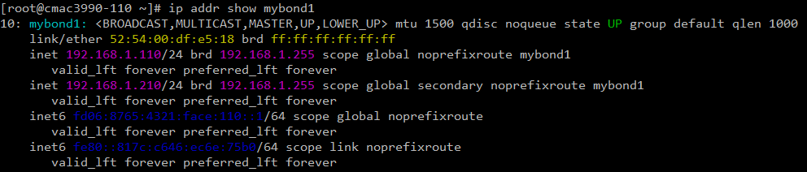
Network Changes
Add a new IPv6 address to the new bond interface
  nmcli con mod "bond-mybond1" ipv6.method manual ipv6.address "fd06:8765:4321:face:1##::1/64"
Enable new IPv6 address
  nmcli con up bond-mybond1
Add a new IPv4 VIP to the new bond interface
  nmcli con mod "bond-mybond1" +ipv4.addresses "192.168.1.2##/24"
Enable new IPv4 VIP address
  nmcli con up bond-mybond1

Slide 69
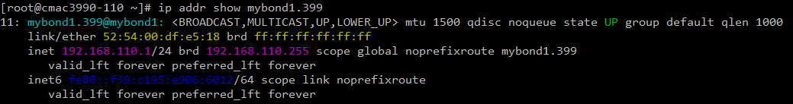
Network Changes
Add VLAN 399 on new device mybond1 and configure an IP address
  nmcli con add type vlan con-name "bond-mybond1.399" dev mybond1 id 399
  nmcli con mod "bond-mybond1.399" ipv4.method manual ipv4.address "192.168.1##.1/24"
  nmcli con up "bond-mybond1.399"

Slide 70

Docker Compose
A tool for defining and running multi-container Docker applications
Use YAML to configure application and services
  YAML - human-readable data serialization language
Multiple environments per host
Persistent data volume
Configure in a Compose variable file
Automated testing environments
Django, Rails, Wordpress, More...
  https://docs.docker.com/compose
Notes:
YAML: YAML Ain't Markup Language What It Is: YAML is a human friendly data serialization standard for all programming languages.

Slide 71

Switch to Docker CE & Compose
I want to change our version of Docker….
  This was our “intentional rework” !
  Lets change to docker-ce
    Remove any of the old/incorrect stuff
        docker stop $(docker ps -a -q)
        docker rm $(docker ps -a -q)
        echo y | docker system prune -a
        dnf -y remove docker
    Install, start, and enable the new docker and podman packages
        dnf config-manager --add-repo https://download.docker.com/linux/rhel/docker-ce.repo
        dnf -y install docker-ce docker-ce-cli containerd.io docker-buildx-plugin
        dnf -y install docker-compose-plugin podman
        systemctl enable docker --now
        systemctl enable podman.socket --now

Slide 72
Switch to Docker CE & Compose
Move our manually compiled Apache installation to port 8081
  Port 8080 will conflict with our new Docker installs!
    Open the firewall port, change the setting, and restart Apache
        firewall-cmd --zone=public --add-port=8081/tcp
        firewall-cmd --zone=public --add-port=8081/tcp --permanent
        sed -i 's/8080/8081/g' /usr/local/apache2/conf/httpd.conf
        /usr/local/apache2/bin/apachectl restart
    Validate by visiting the website on port 8081:
      http://147.64.243.1##:8081
        curl http://147.64.243.1##:8081
          It works!
Now we can look at doing some installs!
  It took me way to long to get here…

Slide 73
ownCloud
Change DNS server listeners!
  ownCloud has its own DNS service that must listen on the private IP address it creates for itself…
    Our existing DNS server conflicts with it!
  Edit the /etc/named.conf file and update the ipv4 listen-on port option:
    We must change from listening on all IPv4 address, to only our selected addresses:
      listen-on port 53 { 147.64.243.1##; 192.168.1.1##; };
  Restart the named service to apply the change
    systemctl restart named
  Validate
    netstat -anlpt | grep LISTEN | grep -v tcp6 | grep :53

Slide 74
ownCloud
Container install with Docker Compose
  Download ownCloud docker image
    mkdir -p /docker/owncloud
    cd /docker/owncloud
    wget https://jpatalon.cs.edinboro.edu/cmac3990/classfiles/owncloud.docker-compose.yml -O ./docker-compose.yml
    Create ownCloud config file
    cat << EOF > .env
    OWNCLOUD_VERSION=10.15
    OWNCLOUD_DOMAIN=localhost:8080
    OWNCLOUD_TRUSTED_DOMAINS=localhost,147.64.243.1##
    ADMIN_USERNAME=admin
    ADMIN_PASSWORD=admin
    HTTP_PORT=8080
    EOF
Make sure to use your 2-digit number!

Slide 75
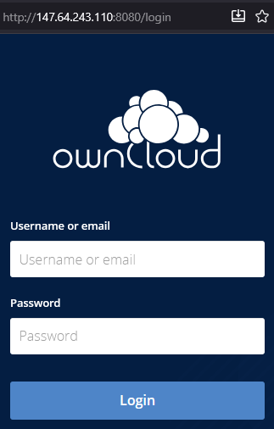
ownCloud
Container install with Docker Compose
  Start and monitor ownCloud Docker image
    docker compose up -d
    docker ps
ownCloud Docker Compose yaml starts three Docker containers:
  MariaDB: A mySQL compatible database
  Redis: An in-memory database/cache/broker
  ownCloud: The ownCloud server itself
Check website:
  http://147.64.243.1##:8080
  Login with username/password from environment file (admin/admin)
      Optionally change your password after installing!

Slide 76
NextCloud
Container install with Docker
  Install Nextcloud with Docker
      cd /docker
      docker pull nextcloud
      docker run -d -p 81:80 --name=nextcloud_1 --restart=always nextcloud
      firewall-cmd --zone=public --add-port=81/tcp
      firewall-cmd --zone=public --add-port=81/tcp --permanent
  Log in and create an admin account
    http://1##.megastuff.biz:81
    http://147.64.243.1##:81
    Create admin account
    Leave the storage and database as default
    Wait for installation to finish
    Optionally install the recommended apps…
Notes:
I could not get docker-compose install to fully work here, database issues…
#download nextcloud docker image
mkdir -p /docker/nextcloud
cd /docker/nextcloud
wget https://jpatalon.cs.edinboro.edu/csci425/classfiles/nextcloud.docker-compose.yml -O ./docker-compose.yml
sed -i 's/YOUR_NUMBER/14/g' ./docker-compose.yml
#start nextcloud docker image
docker-compose up -d
docker ps

Slide 77
LVM and Disk Maintenance
Display a list of disks
  fdisk -l (lowercase L)
  Interactive with fdisk /dev/sdX
Display a list of physical volumes
  Name, size, volume group, extent size, available size, UUID
  pvdisplay
Display a list of volume groups
  Name, total size, extent size, available size, UUID
  vgdisplay
Display a list of logical volumes
  LV name, VG name, size, path, total size, block size, UUID
  lvdisplay

Slide 78
Disks, Volume Groups, and Logical Volumes
LVM – Logical Volume Management
Check local root disk size
    [root@ecsc3990-110 ~]# df -h /
    Filesystem Size Used Avail Use% Mounted on
    /dev/mapper/cs-root 75G 17G 59G 23% /
Check list of local physical volumes
    [root@cmac3990-110 ~]# pvdisplay
    --- Physical volume ---
    PV Name /dev/vda2
    VG Name cs
    PV Size <74.01 GiB / not usable 4.00 MiB
    Allocatable yes (but full)
    PE Size 4.00 MiB
    Total PE 18945
    Free PE 0
    Allocated PE 18945
    PV UUID fBbsdQ-Eyqk-30cK-FRyA-tRKA-UmCj-vZS1Rk
    --- Physical volume ---
    PV Name /dev/vda3
    VG Name cs
    PV Size 24.99 GiB / not usable 3.00 MiB
    Allocatable yes (but full)
    PE Size 4.00 MiB
    Total PE 6397
    Free PE 0
    Allocated PE 6397
    PV UUID WfUez0-RdXv-Jtww-Cy2Y-HYBi-p67N-w9nAcQ

Slide 79
Disks, Volume Groups, and Logical Volumes
Check list of local volume groups
    [root@cmac3990-110 ~]# vgdisplay
    --- Volume group ---
    VG Name cs
    System ID
    Format lvm2
    Metadata Areas 2
    Metadata Sequence No 6
    VG Access read/write
    VG Status resizable
    MAX LV 0
    Cur LV 3
    Open LV 3
    Max PV 0
    Cur PV 2
    Act PV 2
    VG Size 98.99 GiB
    PE Size 4.00 MiB
    Total PE 25342
    Alloc PE / Size 25342 / 98.99 GiB
    Free PE / Size 0 / 0
    VG UUID foOStU-ClMZ-4jey-W3Ct-Y5vG-UGX5-bwQB5l

Slide 80
Disks, Volume Groups, and Logical Volumes
Check list of local logical volumes
    [root@cmac3990-110 ~]# lvdisplay
    --- Logical volume ---
    LV Path /dev/cs/swap
    LV Name swap
    VG Name cs
    LV UUID ioC2L7-Tr9d-ZS26-nh7O-asi9-A1yc-sJPtiI
    LV Write Access read/write
    LV Creation host, time localhost.localdomain, 2025-01-18 20:18:54 -0500
    LV Status available
    # open 2
    LV Size 4.00 GiB
    Current LE 1024
    Segments 1
    Allocation inherit
    Read ahead sectors auto
    - currently set to 256
    Block device 253:1

Slide 81
Disks, Volume Groups, and Logical Volumes
Check list of local logical volumes
    [root@cmac3990-110 ~]# lvdisplay
    --- Logical volume ---
    LV Path /dev/cs/home
    LV Name home
    VG Name cs
    LV UUID K4AQnv-FDYc-aO9T-J5hd-JcRP-5cv1-SYKeZ1
    LV Write Access read/write
    LV Creation host, time localhost.localdomain, 2025-01-18 20:18:54 -0500
    LV Status available
    # open 1
    LV Size 20.00 GiB
    Current LE 5120
    Segments 1
    Allocation inherit
    Read ahead sectors auto
    - currently set to 256
    Block device 253:2

Slide 82
Disks, Volume Groups, and Logical Volumes
Check list of local logical volumes
    [root@cmac3990-110 ~]# lvdisplay
    --- Logical volume ---
    LV Path /dev/cs/root
    LV Name root
    VG Name cs
    LV UUID A883hu-W8rv-vQIj-SK32-FGN7-klVY-K3Fdfi
    LV Write Access read/write
    LV Creation host, time localhost.localdomain, 2025-01-18 20:18:55 -0500
    LV Status available
    # open 1
    LV Size 74.99 GiB
    Current LE 19198
    Segments 2
    Allocation inherit
    Read ahead sectors auto
    - currently set to 256
    Block device 253:0

Slide 83
Disks, Volume Groups, and Logical Volumes
Disk: /dev/vda
    [root@cmac3990-110 ~]# fdisk –l /dev/vda
    Disk /dev/vda: 100 GiB, 107374182400 bytes, 209715200 sectors
    Units: sectors of 1 * 512 = 512 bytes
    Sector size (logical/physical): 512 bytes / 512 bytes
    I/O size (minimum/optimal): 512 bytes / 512 bytes
    Disklabel type: dos
    Disk identifier: 0x5a1a59a0
    Device Boot Start End Sectors Size Id Type
    /dev/vda1 * 2048 2099199 2097152 1G 83 Linux
    /dev/vda2 2099200 157304831 155205632 74G 8e Linux LVM
    /dev/vda3 157304832 209715199 52410368 25G 8e Linux LVM
VDA
100GB
3 partitions

Slide 84
Disks, Volume Groups, and Logical Volumes
Disk: /dev/vdb
    [root@cmac3990-110 ~]# fdisk –l /dev/vdb
    Disk /dev/vdb: 10 GiB, 10737418240 bytes, 20971520 sectors
    Units: sectors of 1 * 512 = 512 bytes
    Sector size (logical/physical): 512 bytes / 512 bytes
    I/O size (minimum/optimal): 512 bytes / 512 bytes
VDB
10GB
0 partitions

Slide 85
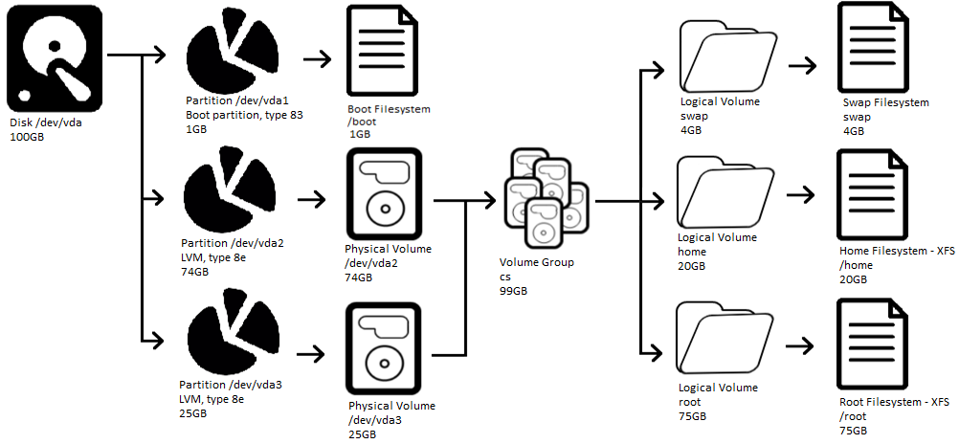
Disks, Volume Groups, and Logical Volumes
Disk:
/dev/vda
Current state Assignment 10 added /dev/vda3

Slide 86
Physical Disk and Volume
Create a new disk partition on device /dev/vdb
  fdisk /dev/vdb
    New primary partition #1, 1GB disk size
        n, p, 1, 2048, +1G
    Change the partition type to Linux LVM
        t, 8e
    View the new disk configuration
      p
    Write the changes to disk
        w
Scan for new partitions
  partprobe
Create a physical volume
  pvcreate /dev/vdb1
New vdb1 partition!

Slide 87
LVM & File System Config
Extend the existing cs volume group
    vgextend cs /dev/vdb1
    vgscan
Create a new lv_data logical volume
  We could optionally expand an existing LV or create a new LV here…
    lvcreate -n lv_data -l 100%FREE cs
Create a new XFS file system…
    mkfs.xfs /dev/cs/lv_data
Make a new directory and mount the new filesystem…
    mkdir -p /data
    echo "/dev/mapper/cs-lv_data /data xfs defaults 0 0" >> /etc/fstab
    systemctl daemon-reload
    mount -a
Add vdb1 to new LVM!

Slide 88
LVM & File System Config
Validate!
    [root@ecsc3990-110 ~]# df -h /data
    Filesystem Size Used Avail Use% Mounted on
    /dev/mapper/cs-lv_data 956M 39M 918M 5% /data
Disk: /dev/vdb
    [root@cmac3990-110 ~]# fdisk -l /dev/vdb
    Disk /dev/vdb: 10 GiB, 10737418240 bytes, 20971520 sectors
    Units: sectors of 1 * 512 = 512 bytes
    Sector size (logical/physical): 512 bytes / 512 bytes
    I/O size (minimum/optimal): 512 bytes / 512 bytes
    Disklabel type: dos
    Disk identifier: 0x8ff612c3
    Device Boot Start End Sectors Size Id Type
    /dev/vdb1 2048 2099199 2097152 1G 8e Linux LVM

Slide 89
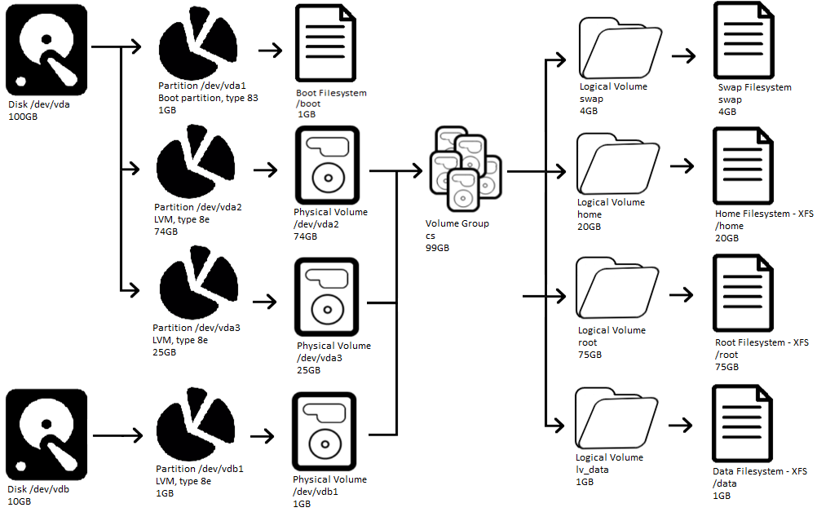
Disks, Volume Groups, and Logical Volumes
Disk:
/dev/vdb
New vdb1 partition!
Notes:
Assignment 11

Slide 90
Physical Disk and Volume
We still have 9GB of space available on disk /dev/vdb…
  [root@cmac3990-110 ~]# fdisk -l /dev/vdb
  Disk /dev/vdb: 10 GiB, 10737418240 bytes, 20971520 sectors
  Units: sectors of 1 * 512 = 512 bytes
  Sector size (logical/physical): 512 bytes / 512 bytes
  I/O size (minimum/optimal): 512 bytes / 512 bytes
  Disklabel type: dos
  Disk identifier: 0x8ff612c3
  Device Boot Start End Sectors Size Id Type
  /dev/vdb1 2048 2099199 2097152 1G 8e Linux LVM
Maybe we can use that in the future? Assignment 13?
  Create a new partition & physical volume?
  Create a new Volume Group?
  Create a new Logical Volume?
  Create a new filesystem and mount point?
  Add to an existing mount point?
  Increase swap?
Future?

Slide 91
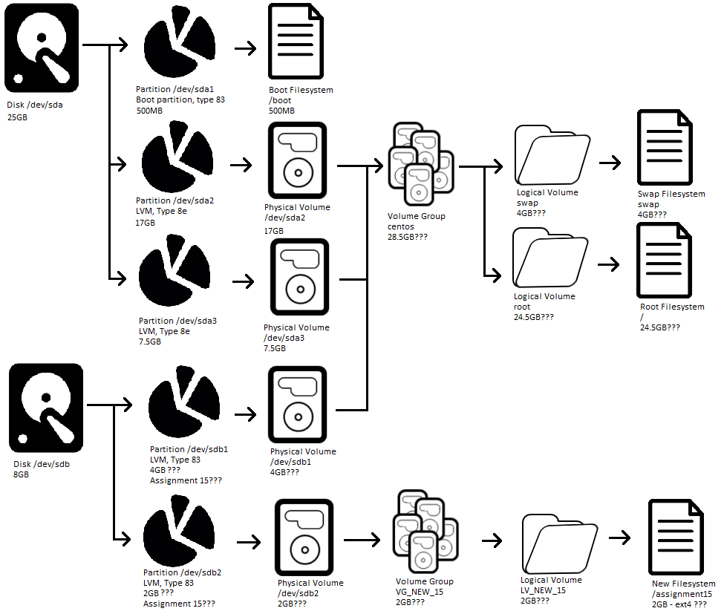
Disks, Volume Groups, and Logical Volumes
Disks: /dev/vda and /dev/vdb
Future?

Slide 92
Assignment 12
72 Points – Due November 21st
Create a new network bond
  Create new VIPs and VLANs as specified
Change to Docker-CE
  Remove old Docker packages
  Install Docker Compose and related packages
  Deploy containers with Docker Compose
Create a new disk partition
  Create and add /dev/vdb1 to existing VG
  Create a new Logical Volume and /data mount point
Update, reboot, and document!

Slide 93
Linux Commands
ssh
scp
iptables
ip6tables
systemctl get-default
systemctl set-default
firewall-cmd
Apachectl
nmap
ping
mkdir
rsync
crontab
./configure
make
make install
cp
crontab

Slide 94

Key Terms and Items
Denial of Service (DoS)
Distributed DoS (DDoS)
SYN flood attack
UDP flood attack
Port scan attack
Ping of death
IP Spoofing
Land attack
Tear drop attack
Ping scan attack
Brute Force
ICMP Flood
Packet sniffing
Target of opportunity
Target of choice
Script kiddie
Reconnaissance and footprinting
Scanning
Enumeration
Gaining access
Escalating
Creating backdoors
Covering your tracks
Honeypot
Passive vs. Active reconnaissance
Security policies

Slide 95
Key Terms and Items
SSH
Symmetrical encryption
Asymmetrical encryption
Hashing
E-Mail
Mail Transport Agent (MTA)
Mail Delivery Agent (MDA)
Mail User Agent (MUA)
VoIP
Types of IP phones
Firewalls
Deontological theories
Consequentialist theories
Netfilter
Source NAT
Destination NAT
Firewalld
Remote Access Service
Virtual Network Computing (VNC)
Simple Network Management Protocol (SNMP)
Runlevels
Compiling
Stakeholders
Positive rights
Negative rights

Slide 96
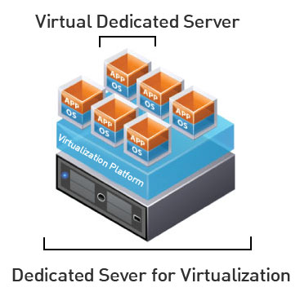
Virtual Machines
VM Info:
  IP Address: 147.64.243.1##/23 (01-20) – bond0
  Hostname: ecsc425-1##.cs.edinboro.edu (01-20)
  Alias: 41##.megastuff.biz (01-20)
  Samba: \\147.64.243.1##\ (01-20)
  Interfaces:
    Enp1s0, enp8s0, enp9s0, enp10s0, mybond0, mybond0.6, mybond0.110, mybond0.187, mybond1???
  Additional IP’s??? Future???
    mybond0 – 147.64.243.1## & 147.64.243.150+##/23
    mybond0.6 – fd06:1234:5678:beef:1##::1/64
    mybond0.110 – 10.10.1##.1/16
    mybond0.187 – 10.1.187.1##/22
    mybond1 – 192.168.1.1##/24 & 192.168.1.2##/24 & fd06:8765:4321:face:1##::1/64
    mybond1.399 – 192.168.1##.25/19

Slide 97

For Next Week
“They who can give up essential liberty to obtain a little temporary safety deserve neither liberty nor safety.” -Benjamin Franklin
Week 12 – November 7/9, 2022
  Network Security Issues
  Information Security Awareness
  Security Tools and Assessment Sites
Reading – Chapters 29 & 30
  Chapter 29: Performance Analysis
  Chapter 30: Data Center Basics

